Slide 1
Lecture 3
Array of pointers; pointers to structure, array of structures.

Slide 2
Array of pointers
A 2_D array is an arrays of pointers and like 1_d arrays each elements can be accessed using subscripts or pointers / double pointers
2_D array of integers:
int matrix[3][4]; //declare 2_D array
Access individual elements using subscripts:
printf(“ value of row 2 col 2 is %d”, matrix[1][1]);
Access elements using pointers
printf(“ value of row 2 col 2 is %d”, *((*matrix + 1) + 1));
(*matrix + 1)
*((*matrix + 1) +1)
Explain the above statements ?

Slide 3
Manipulate 2_D array
To access each element you need to use nested for loops; consider a 3x3 matrix
To print each value
for (row = 0; row<3; row++)
for (col = 0; col <3; col++ )
printf(“matrix[row][col] “); // can also use pointer arithmetic
How would you determine the result of the addition of two such matrices.
How would you perform matrix multiplication of two matrices?

Slide 4
Array of string pointers
If you wanted to create an array to store all the months [strings] of the year you could
Create a 2_d character array: char month[12][10]
Why would this be inefficient?
Another option is to create an array of characters pointers: char *months[12]
Each row is then treated an a char * (string)
Remember you must assign memory for each char *
Consider the following program

Slide 5
Display months
#include <stdio.h>
void main()
{
/* Define an array of strings */
char *months[12] = {"January", "February", "March", "April", "May", "June", "July", "August", "September", "October", "November", "December" };
int i;
/* Display the months of the year using subscripts */
printf("The months of the year are:\n\n");
for(i = 0; i< 12; i++)
printf("%s\n", months[i]);
/* Display the months of the year using pointer arithmetic */
printf("The months of the year are:\n\n");
for(i = 0; i< 12; i++)
printf("%s\n", *(months +i));
}

Slide 6
Structures
A structure is a heterogeneous data structure; e.g.
struct personnel /* Structure template for employee */
{
int number;
char surname[26];
char initial;
char dob [8];
int dept;
char date_joined [8];
};
// declare a variable for a structure
struct personnel person;

Slide 7
Nested structures and pointers
struct date /* Structure template for a date */
{
int day;
int month;
int year;
};
struct personnel /* Structure template for employee */
{
int number;
char surname[26];
char initial;
struct date dob;
int dept;
struct date joined;
};
struct personnel person; // declaring a variable to a structure
struct personnel *ptr; //declaring a pointer to a structure

Slide 8
Using structure
The following are examples of accessing fields
Using the . operator
person.surname // it’s a string (a primary field)
person.dob.day // a field of a nested structure
person.dept
Using pointer notations
ptr = &person // assign struct to a pointer
ptr -> surname;
ptr ->dob.day;

Slide 9
Passing a structure to a function
Like another other data types A structure can be passed by value or by reference.
By value “ pass the structure” and by reference “a pointer to the structure”.
Do not forget to use the appropriate notation in each function (if struct use the dot operator; if prt use the ->

Slide 10
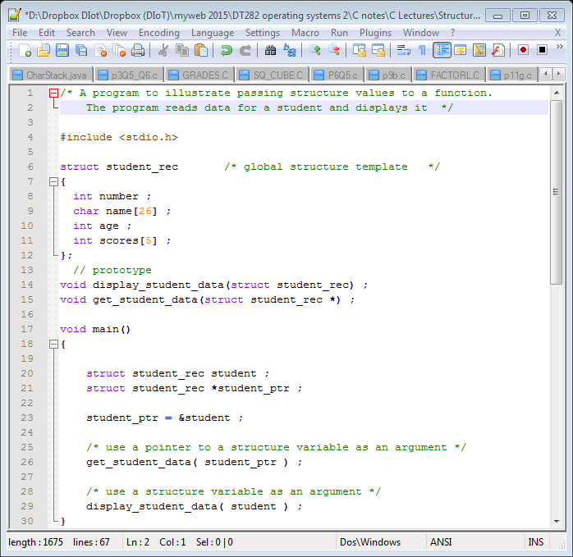
Structures to functions

Slide 11
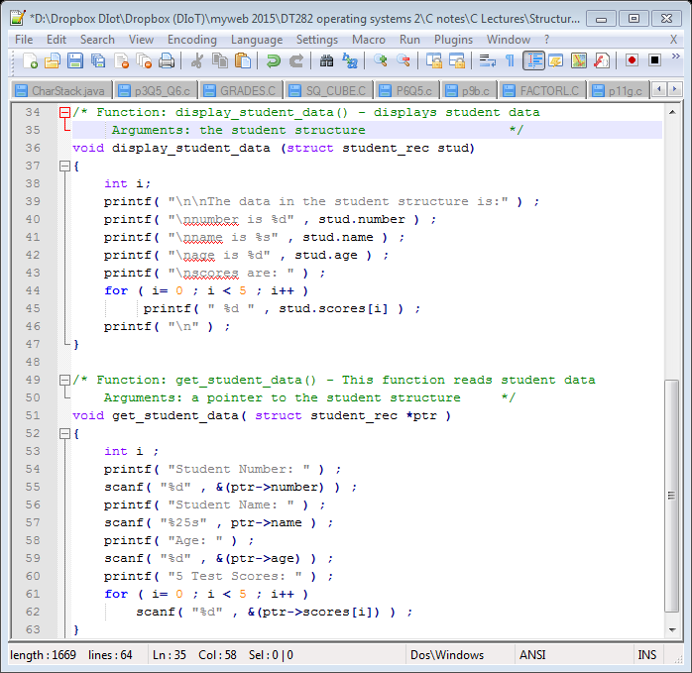

Slide 12
Array of structure
An array can also hold structures
Typedef
Typedef Struct personnel EMPLOYEE
Declare an array of structures
EMPLOYEE staff[20];
The emp.c is a program that declares an array of structures and then allows the user to
Add a record in the form a of struct
Delete a record
Display a record
Edit a record

Slide 13
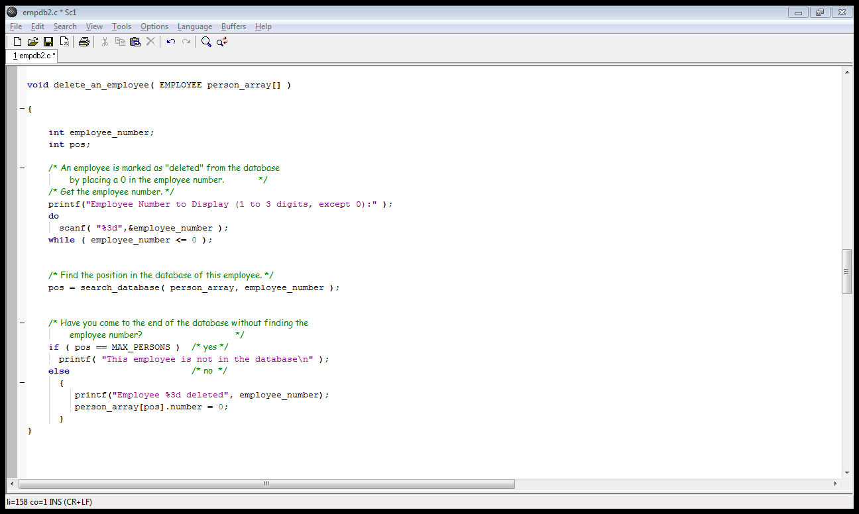
Array of structures
The program initialise one field of each record to be zero to indicate an empty position
The delete fnt.

